Slide 1
Astro 331 Lesson 4
Introduction to Astrodynamics
SMAD Ch 6.2, 6.5

Slide 2
Lesson Objectives
Describe the limitations of the assumptions of the restricted two-body equation of motion
Identify common orbital perturbations and the orbital regimes in which they apply
Describe the unique features of sun-synchronous and Molniya orbits
Calculate perturbations to orbital elements caused by the sun, the moon, Earth’s oblateness, and atmospheric drag
Estimate orbital maintenance requirements necessary to compensate for perturbations
Describe end-of-life disposal options for spacecraft and understand which mission types utilize which option

Slide 3
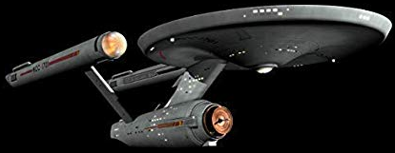

Equation of Motion
0
0
0
0
$ΣF=F_{thrust}+F_{drag}$+$F_{gravity}$+$F_{3rd body}$+$F_{other}$
3rd Body
Other
Thrust
Drag
Gravity

Slide 4
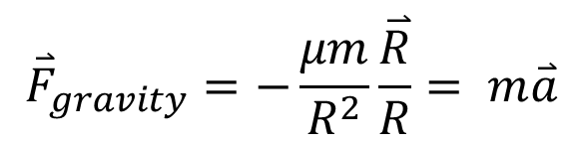


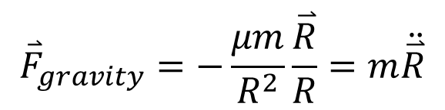
Restricted 2-Body EOM
$Σ{\overset{⃑}{F}}_{external}=$ ${\overset{⃑}{F}}_{gravity}=m\overset{⃑}{a}$
$${\overset{⃑}{F}}_{gravity}=−\frac{μm}{R^{2}}\frac{\overset{⃑}{R}}{R}= m\overset{⃑}{a}$$
Apply Newton’s Universal Law of Gravitation
$${\overset{⃑}{F}}_{gravity}=−\frac{μm}{R^{2}}\frac{\overset{⃑}{R}}{R}=m\ddot{\overset{⃑}{R}}$$
$$\ddot{\overset{⃑}{R}}+\frac{μ}{R^{2}}\hat{R}=0$$

Slide 5
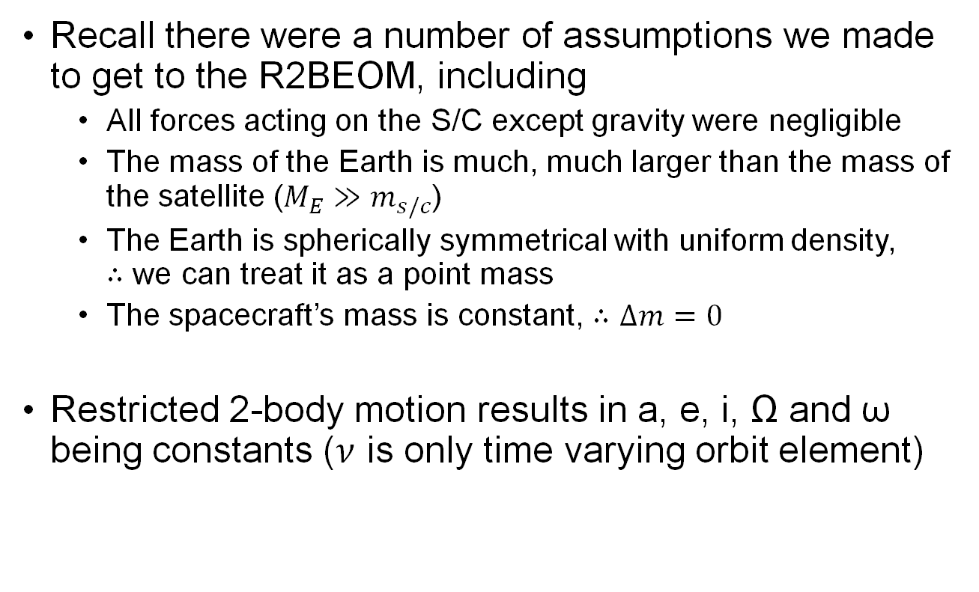
Recall there were a number of assumptions we made to get to the R2BEOM, including
All forces acting on the S/C except gravity were negligible
The mass of the Earth is much, much larger than the mass of the satellite ($M_{E}≫m_{s/c}$)
The Earth is spherically symmetrical with uniform density, $∴$ we can treat it as a point mass
The spacecraft’s mass is constant, $∴$ $Δm=0$
Restricted 2-body motion results in a, e, i, Ω and ω being constants ($ν$ is only time varying orbit element)

Slide 6
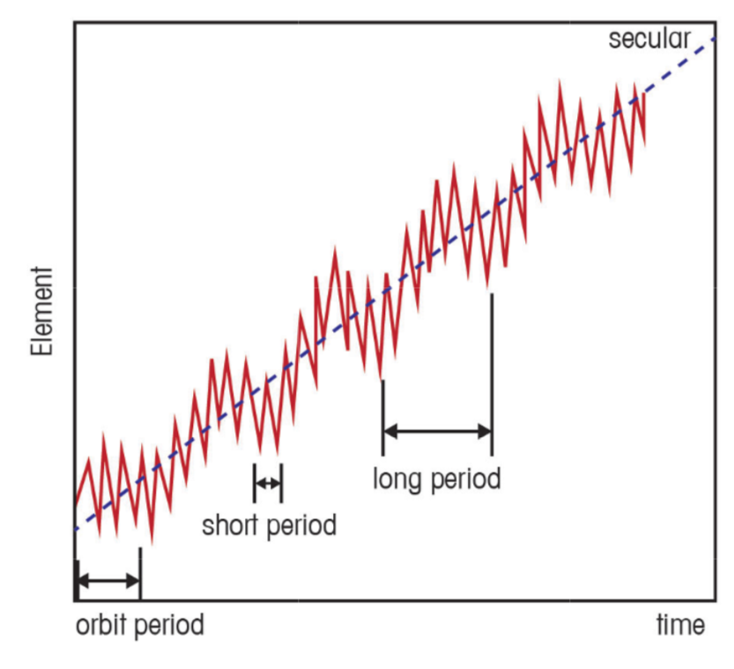
Perturbations
Perturbations are forces that cause S/C motion to deviate from ideal 2-body motion
Perturbation classifications
secular: non periodic
short-period: < 1 orbit period
long-period: > 1 orbit period
Common perturbations:
3rd body
non-spherical Earth
atmospheric drag
solar radiation pressure
Fig 6-6 Secular and Periodic Variations of an Orbital Element

Slide 7
Fig 6-6 Secular and Periodic Variations of an Orbital Element

Slide 8
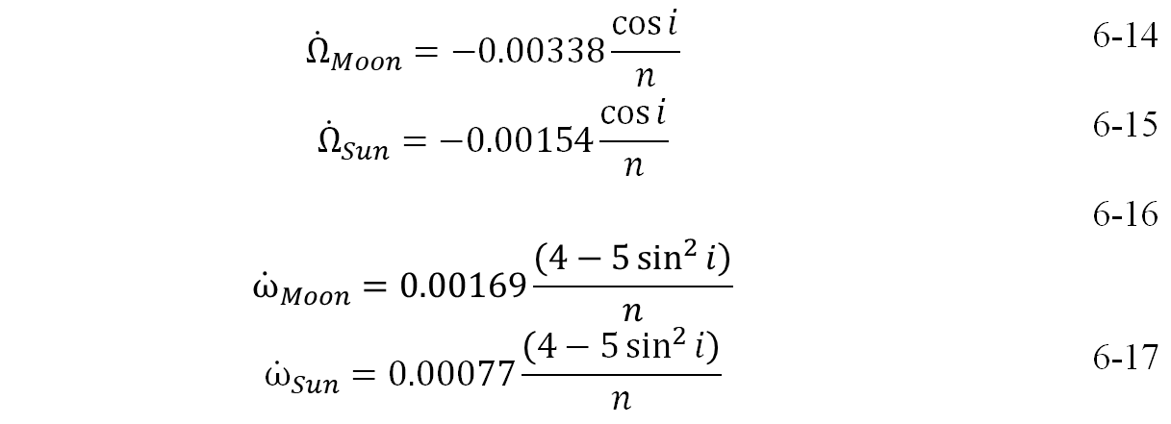
Third Body Effects
Sun and moon are dominant 3rd-body effects for Earth orbiting S/C
periodic effects on all COEs
secular variations in Ω and ω
$${\dot{Ω}}_{Moon}=−0.00338\frac{\cos{i}}{n}$$ | 6-14
$${\dot{Ω}}_{Sun}=−0.00154\frac{\cos{i}}{n}$$ | 6-15
$${\dot{ω}}_{Moon}=0.00169\frac{\left(4−5\sin^{2}{i}\right)}{n}$$ | 6-16
$${\dot{ω}}_{Sun}=0.00077\frac{\left(4−5\sin^{2}{i}\right)}{n}$$ | 6-17
n = mean motion (rev/day) for 3rd body calcs

Slide 9
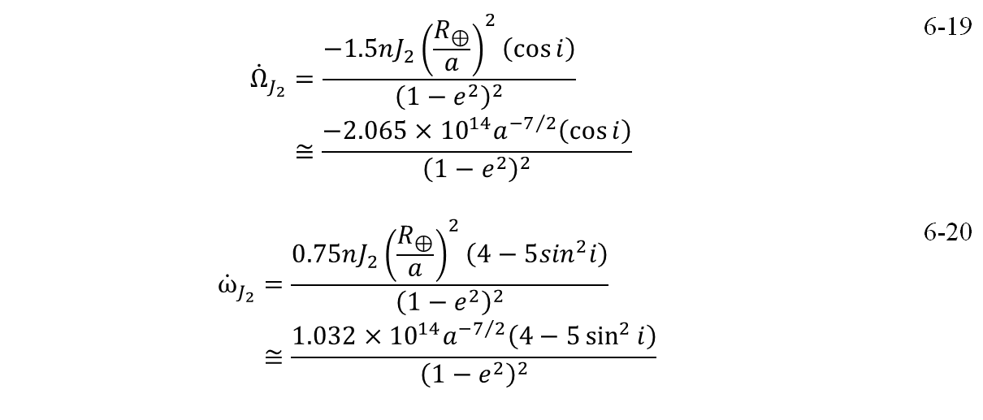
Non-Spherical Earth Effects
largest non-spherical effect is the belt around the equator (oblateness aka J₂)
periodic variation in all COEs
dominant effects are secular variation in Ω and ω
up to about GEO altitude, J₂ has a stronger impact than sun or moon perturbations
beyond GEO, sun and moon perturbations are more dominant than J₂
$${\dot{Ω}}_{J_{2}}=\frac{−1.5nJ_{2}{\left(\frac{R_{⊕}}{a}\right)}^{2}\left(\cos{i}\right)}{{\left(1−e^{2}\right)}^{2}}$$ $$≅\frac{−2.065×{10}^{14}a^{{−7}/2}\left(\cos{i}\right)}{{\left(1−e^{2}\right)}^{2}}$$ | 6-19
$${\dot{ω}}_{J_{2}}=\frac{0.75nJ_{2}{\left(\frac{R_{⊕}}{a}\right)}^{2}\left(4−5\sin^{2}i\right)}{{\left(1−e^{2}\right)}^{2}}$$ $$≅\frac{1.032×{10}^{14}a^{{−7}/2}\left(4−5\sin^{2}{i}\right)}{{\left(1−e^{2}\right)}^{2}}$$ | 6-20
where J₂ = 0.00108263
n = mean motion (deg/day) for oblateness calcs

Slide 10
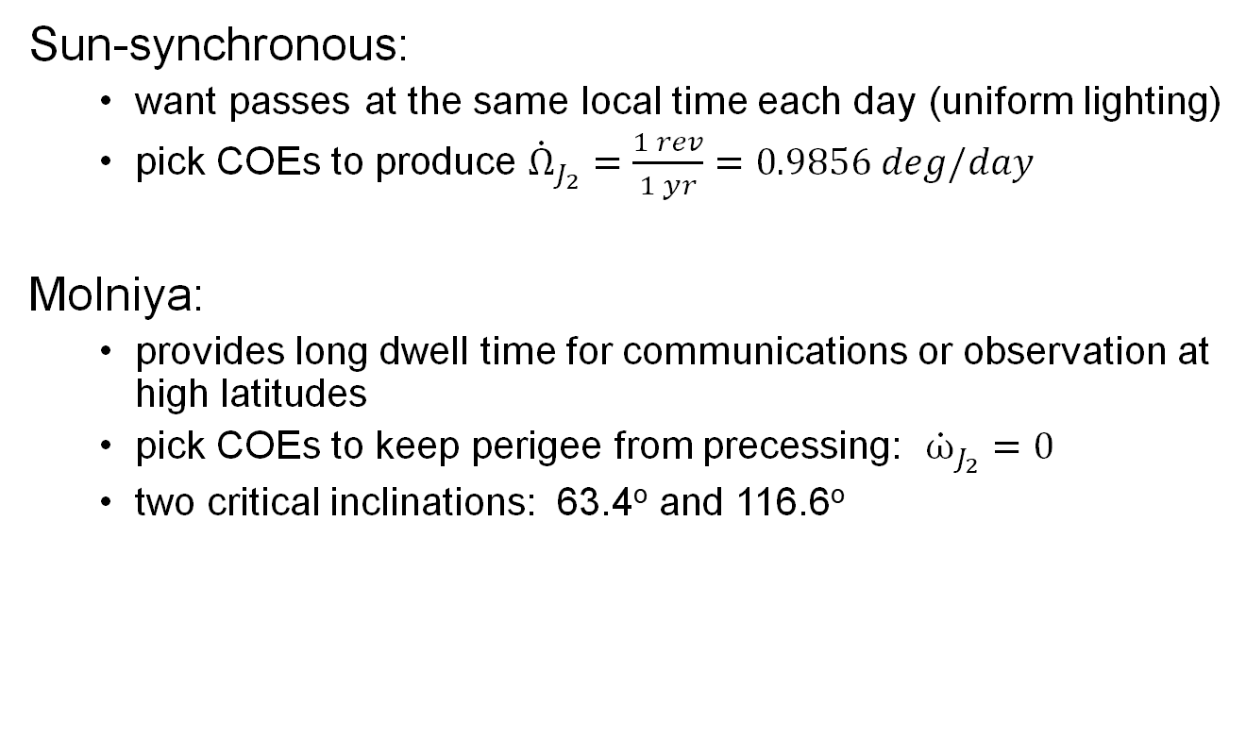
Taking Advantage of Perturbations
Sun-synchronous:
want passes at the same local time each day (uniform lighting)
pick COEs to produce ${\dot{Ω}}_{J_{2}}=\frac{1 rev}{1 yr}=0.9856 deg/day$
Molniya:
provides long dwell time for communications or observation at high latitudes
pick COEs to keep perigee from precessing: ${\dot{ω}}_{J_{2}}=0$
two critical inclinations: 63.4º and 116.6º

Slide 11
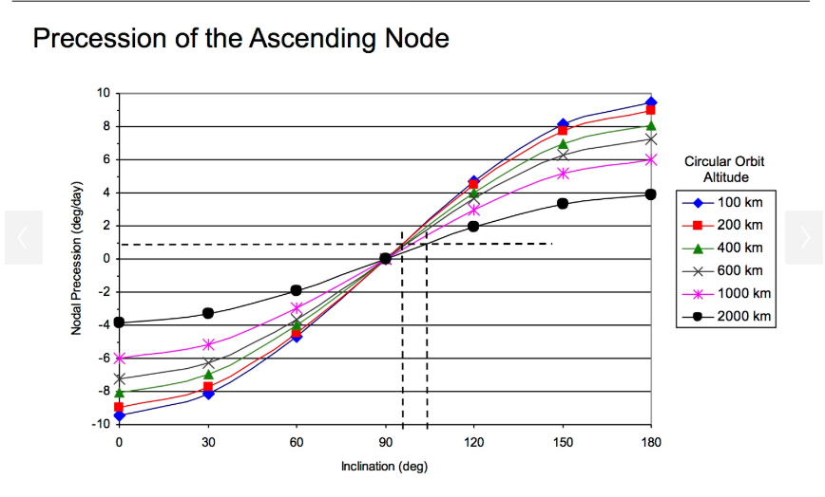
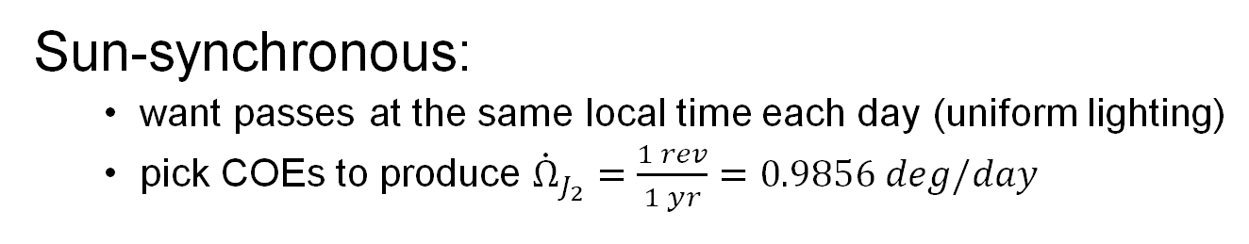
Sun-synchronous:
want passes at the same local time each day (uniform lighting)
pick COEs to produce ${\dot{Ω}}_{J_{2}}=\frac{1 rev}{1 yr}=0.9856 deg/day$

Slide 12
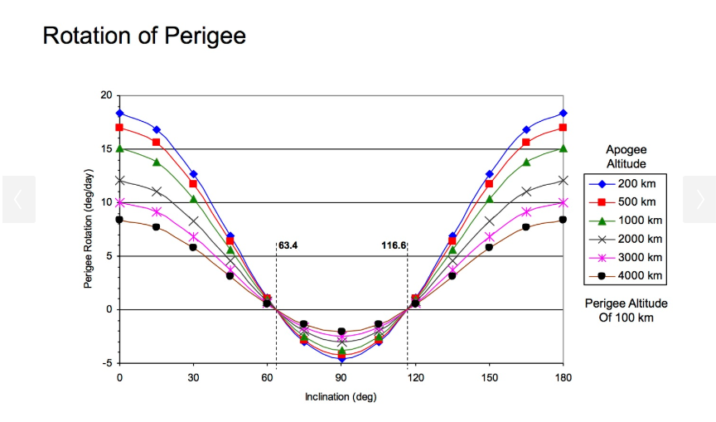

Slide 13
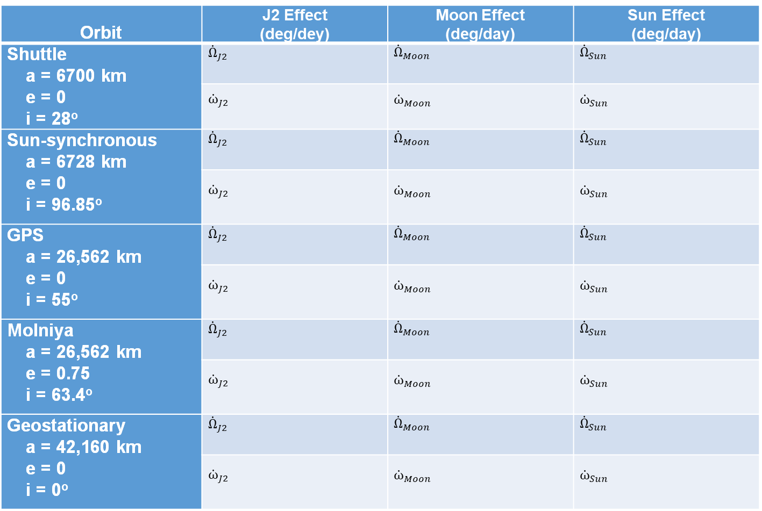
Example – fill in the table
Orbit | J2 Effect (deg/dey) | Moon Effect (deg/day) | Sun Effect (deg/day)
Shuttle a = 6700 km e = 0 i = 28º | ${\dot{Ω}}_{J2}$ | ${\dot{Ω}}_{Moon}$ | ${\dot{Ω}}_{Sun}$
 | ${\dot{ω}}_{J2}$ | ${\dot{ω}}_{Moon}$ | ${\dot{ω}}_{Sun}$
Sun-synchronous a = 6728 km e = 0 i = 96.85º | ${\dot{Ω}}_{J2}$ | ${\dot{Ω}}_{Moon}$ | ${\dot{Ω}}_{Sun}$
 | ${\dot{ω}}_{J2}$ | ${\dot{ω}}_{Moon}$ | ${\dot{ω}}_{Sun}$
GPS a = 26,562 km e = 0 i = 55º | ${\dot{Ω}}_{J2}$ | ${\dot{Ω}}_{Moon}$ | ${\dot{Ω}}_{Sun}$
 | ${\dot{ω}}_{J2}$ | ${\dot{ω}}_{Moon}$ | ${\dot{ω}}_{Sun}$
Molniya a = 26,562 km e = 0.75 i = 63.4º | ${\dot{Ω}}_{J2}$ | ${\dot{Ω}}_{Moon}$ | ${\dot{Ω}}_{Sun}$
 | ${\dot{ω}}_{J2}$ | ${\dot{ω}}_{Moon}$ | ${\dot{ω}}_{Sun}$
Geostationary a = 42,160 km e = 0 i = 0º | ${\dot{Ω}}_{J2}$ | ${\dot{Ω}}_{Moon}$ | ${\dot{Ω}}_{Sun}$
 | ${\dot{ω}}_{J2}$ | ${\dot{ω}}_{Moon}$ | ${\dot{ω}}_{Sun}$

Slide 14
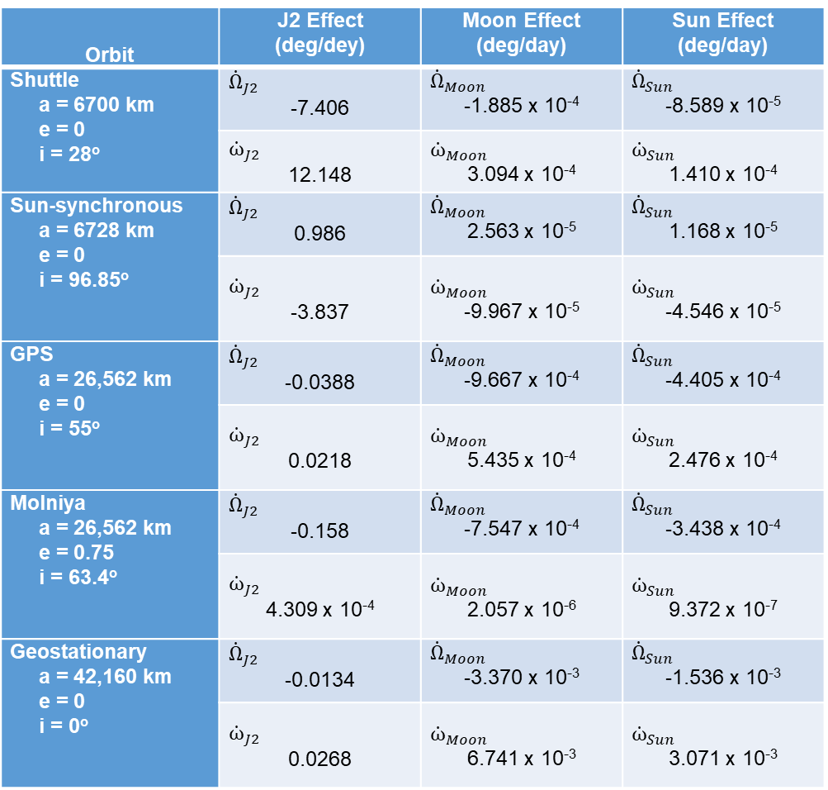
ANSWERS
Orbit | J2 Effect (deg/dey) | Moon Effect (deg/day) | Sun Effect (deg/day)
Shuttle a = 6700 km e = 0 i = 28º | ${\dot{Ω}}_{J2}$ -7.406 | ${\dot{Ω}}_{Moon}$ -1.885 x 10⁻⁴ | ${\dot{Ω}}_{Sun}$ -8.589 x 10⁻⁵
 | ${\dot{ω}}_{J2}$ 12.148 | ${\dot{ω}}_{Moon}$ 3.094 x 10⁻⁴ | ${\dot{ω}}_{Sun}$ 1.410 x 10⁻⁴
Sun-synchronous a = 6728 km e = 0 i = 96.85º | ${\dot{Ω}}_{J2}$ 0.986 | ${\dot{Ω}}_{Moon}$ 2.563 x 10⁻⁵ | ${\dot{Ω}}_{Sun}$ 1.168 x 10⁻⁵
 | ${\dot{ω}}_{J2}$ -3.837 | ${\dot{ω}}_{Moon}$ -9.967 x 10⁻⁵ | ${\dot{ω}}_{Sun}$ -4.546 x 10⁻⁵
GPS a = 26,562 km e = 0 i = 55º | ${\dot{Ω}}_{J2}$ -0.0388 | ${\dot{Ω}}_{Moon}$ -9.667 x 10⁻⁴ | ${\dot{Ω}}_{Sun}$ -4.405 x 10⁻⁴
 | ${\dot{ω}}_{J2}$ 0.0218 | ${\dot{ω}}_{Moon}$ 5.435 x 10⁻⁴ | ${\dot{ω}}_{Sun}$ 2.476 x 10⁻⁴
Molniya a = 26,562 km e = 0.75 i = 63.4º | ${\dot{Ω}}_{J2}$ -0.158 | ${\dot{Ω}}_{Moon}$ -7.547 x 10⁻⁴ | ${\dot{Ω}}_{Sun}$ -3.438 x 10⁻⁴
 | ${\dot{ω}}_{J2}$ 4.309 x 10⁻⁴ | ${\dot{ω}}_{Moon}$ 2.057 x 10⁻⁶ | ${\dot{ω}}_{Sun}$ 9.372 x 10⁻⁷
Geostationary a = 42,160 km e = 0 i = 0º | ${\dot{Ω}}_{J2}$ -0.0134 | ${\dot{Ω}}_{Moon}$ -3.370 x 10⁻³ | ${\dot{Ω}}_{Sun}$ -1.536 x 10⁻³
 | ${\dot{ω}}_{J2}$ 0.0268 | ${\dot{ω}}_{Moon}$ 6.741 x 10⁻³ | ${\dot{ω}}_{Sun}$ 3.071 x 10⁻³

Slide 15
Atmospheric Drag Effects
Drag removes energy from the orbit, which causes the orbit to shrink in both semi-major axis and eccentricity
Drag varies significantly as atmospheric density changes as a result of:
11 yr sun spot cycle
27 day solar rotation cycle
diurnal variations (day/night)
seasonal variations (sun latitude and distance)
rotating atmosphere
winds
magnetic storms
tides

Slide 16
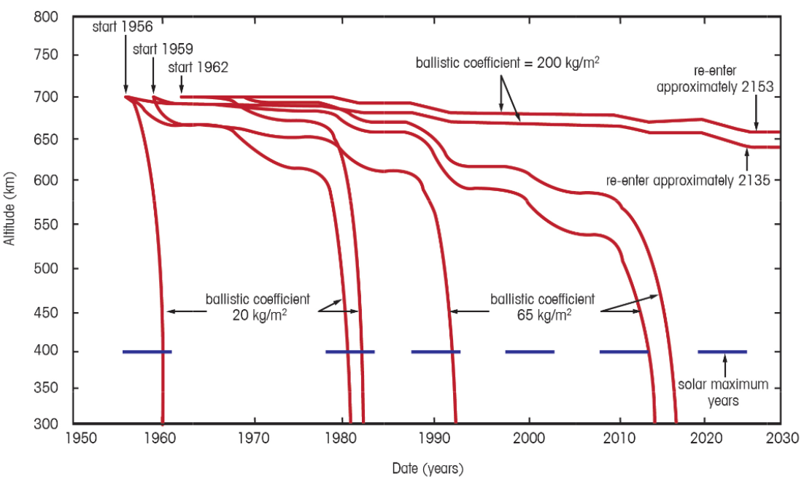
Hypothetical S/C Lifetimes
1962; BC = 200
1956; BC = 200
solar maximum years
1956
BC = 20
1959
BC = 20
1962
BC = 20
1956
BC = 65
1959
BC = 65
1962
BC = 65
adapted from Designing Space Missions and Systems, Fig 8.2

Slide 17
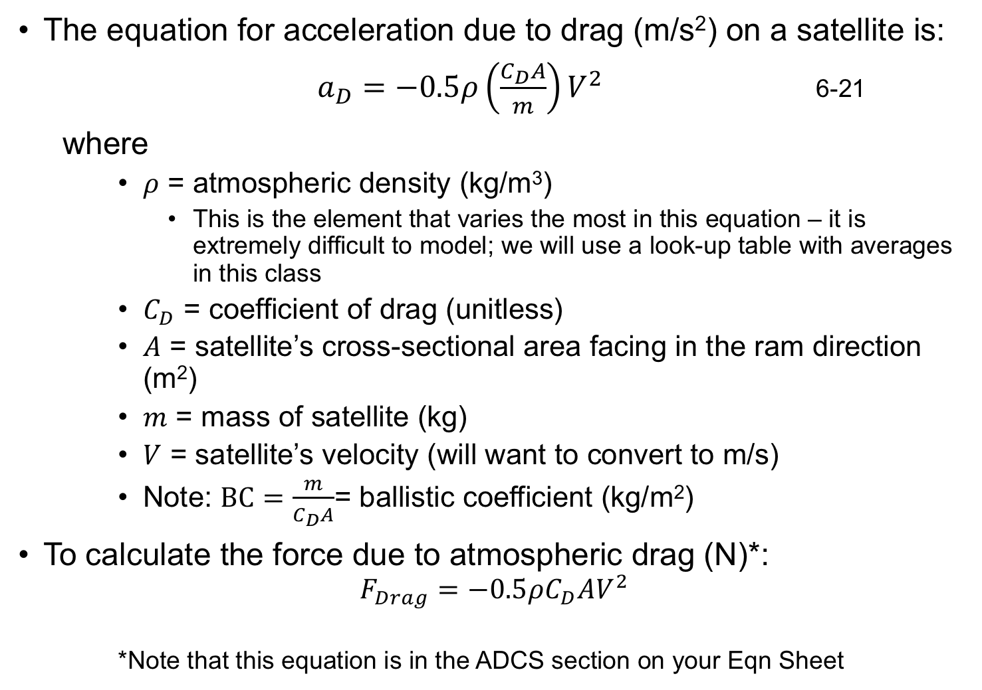
The equation for acceleration due to drag (m/s²) on a satellite is:
$a_{D}=−0.5ρ\left(\frac{C_{D}A}{m}\right)V^{2}$ 6-21
where
$ρ$ = atmospheric density (kg/m³)
This is the element that varies the most in this equation – it is extremely difficult to model; we will use a look-up table with averages in this class
$C_{D}$ = coefficient of drag (unitless)
$A$ = satellite’s cross-sectional area facing in the ram direction (m²)
$m$ = mass of satellite (kg)
$V$ = satellite’s velocity (will want to convert to m/s)
Note: $BC=\frac{m}{C_{D}A}$= ballistic coefficient (kg/m²)
To calculate the force due to atmospheric drag (N)*:
$$F_{Drag}=−0.5ρC_{D}AV^{2}$$
*Note that this equation is in the ADCS section on your Eqn Sheet

Slide 18
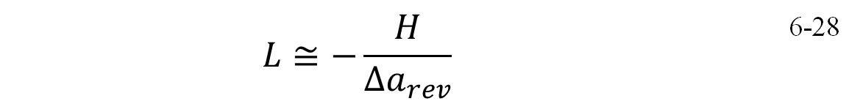
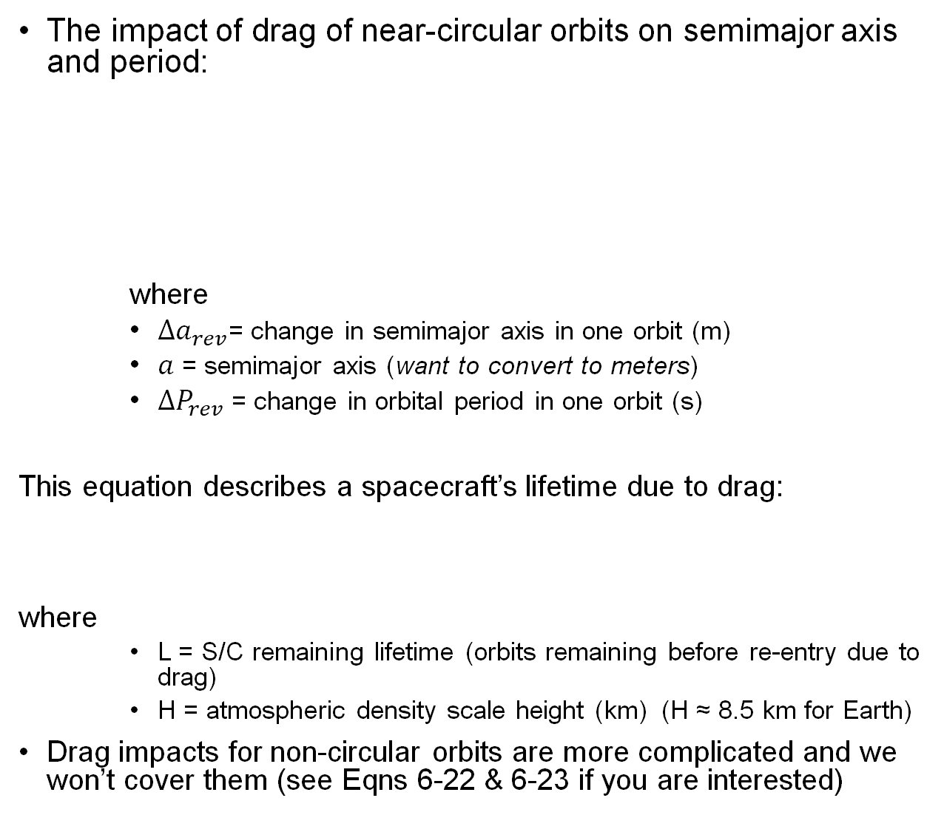

The impact of drag of near-circular orbits on semimajor axis and period:
where
$Δa_{rev}$= change in semimajor axis in one orbit (m)
$a$ = semimajor axis (want to convert to meters)
$ΔP_{rev}$ = change in orbital period in one orbit (s)
This equation describes a spacecraft’s lifetime due to drag:
where
L = S/C remaining lifetime (orbits remaining before re-entry due to drag)
H = atmospheric density scale height (km) (H ≈ 8.5 km for Earth)
Drag impacts for non-circular orbits are more complicated and we won’t cover them (see Eqns 6-22 & 6-23 if you are interested)
$$Δa_{rev}=−2π\left(\frac{C_{D}A}{m}\right)ρa^{2}$$ | 6-24
$$ΔP_{rev}=−6π^{2}\left(\frac{C_{D}A}{m}\right)\frac{ρa^{2}}{V}$$ | 6-25
$$L≅−\frac{H}{Δa_{rev}}$$ | 6-28

Slide 19
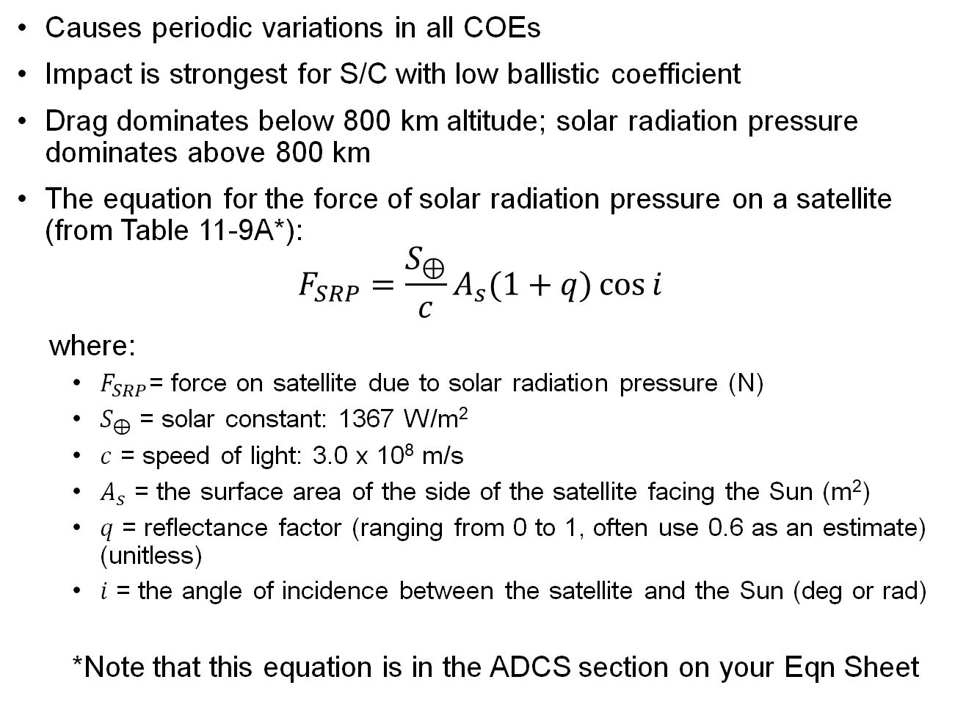
Solar Radiation Pressure (SRP) Effects
Causes periodic variations in all COEs
Impact is strongest for S/C with low ballistic coefficient
Drag dominates below 800 km altitude; solar radiation pressure dominates above 800 km
The equation for the force of solar radiation pressure on a satellite (from Table 11-9A*):
$$F_{SRP}=\frac{S_{⊕}}{c}A_{s}(1+q)\cos{i}$$
where:
$F_{SRP}$= force on satellite due to solar radiation pressure (N)
$S_{⊕}$ = solar constant: 1367 W/m²
$c$ = speed of light: 3.0 x 10⁸ m/s
$A_{s}$ = the surface area of the side of the satellite facing the Sun (m²)
$q$ = reflectance factor (ranging from 0 to 1, often use 0.6 as an estimate) (unitless)
$i$ = the angle of incidence between the satellite and the Sun (deg or rad)
*Note that this equation is in the ADCS section on your Eqn Sheet

Slide 20
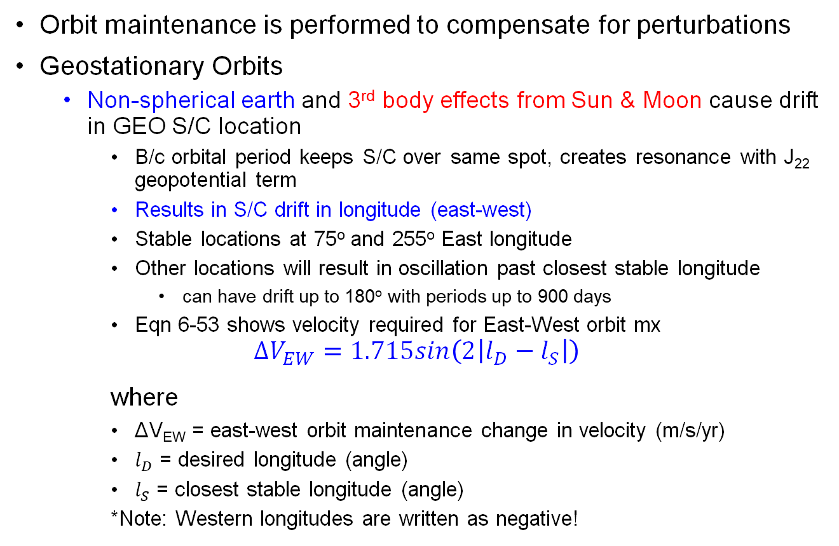
Orbit Maintenance
Orbit maintenance is performed to compensate for perturbations
Geostationary Orbits
Non-spherical earth and 3rd body effects from Sun & Moon cause drift in GEO S/C location
B/c orbital period keeps S/C over same spot, creates resonance with J₂₂ geopotential term
Results in S/C drift in longitude (east-west)
Stable locations at 75º and 255º East longitude
Other locations will result in oscillation past closest stable longitude
can have drift up to 180º with periods up to 900 days
Eqn 6-53 shows velocity required for East-West orbit mx
$$ΔV_{EW}=1.715sin\left(2\left|l_{D}−l_{S}\right|\right)$$
where
ΔV_{EW} = east-west orbit maintenance change in velocity (m/s/yr)
$l_{D}$ = desired longitude (angle)
$l_{S}$ = closest stable longitude (angle)
*Note: Western longitudes are written as negative!

Slide 21
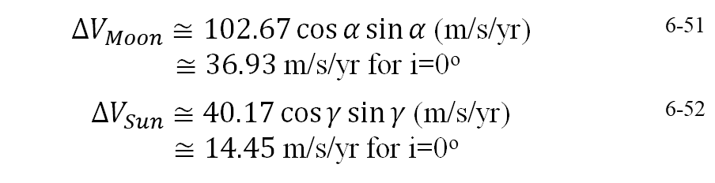
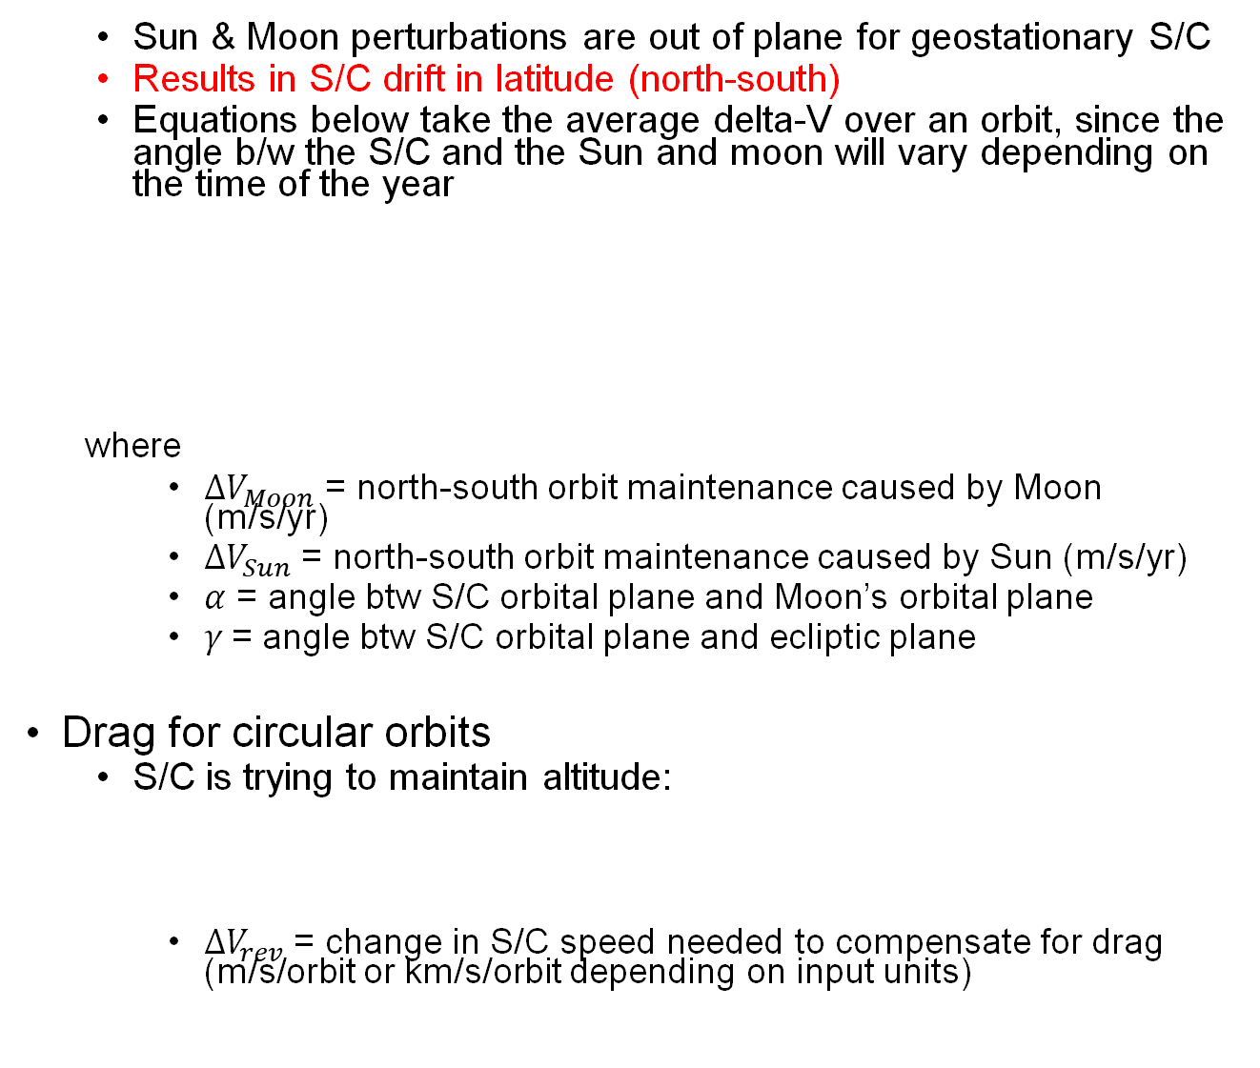

Sun & Moon perturbations are out of plane for geostationary S/C
Results in S/C drift in latitude (north-south)
Equations below take the average delta-V over an orbit, since the angle b/w the S/C and the Sun and moon will vary depending on the time of the year
where
$ΔV_{Moon}$ = north-south orbit maintenance caused by Moon (m/s/yr)
$ΔV_{Sun}$ = north-south orbit maintenance caused by Sun (m/s/yr)
$α$ = angle btw S/C orbital plane and Moon’s orbital plane
$γ$= angle btw S/C orbital plane and ecliptic plane
Drag for circular orbits
S/C is trying to maintain altitude:
$ΔV_{rev}$ = change in S/C speed needed to compensate for drag (m/s/orbit or km/s/orbit depending on input units)
$ΔV_{Moon}≅102.67\cos{α}\sin{α}$ (m/s/yr) $≅36.93$ m/s/yr for i=0º | 6-51
$ΔV_{Sun}≅40.17\cos{γ}\sin{γ}$ (m/s/yr) $≅14.45$ m/s/yr for i=0º | 6-52
$$ΔV_{rev}=π\left(\frac{C_{D}A}{m}\right)ρaV$$ | 6-26

Slide 22
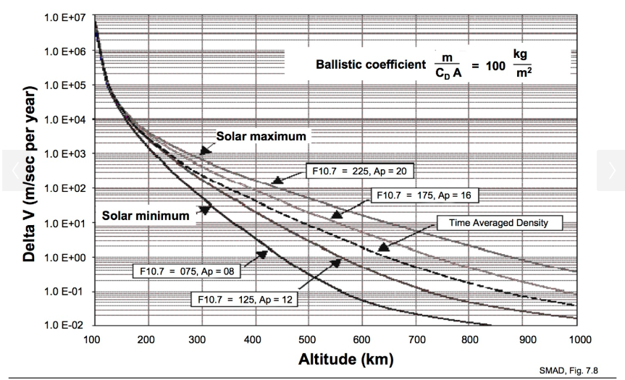
Altitude Maintenance ΔVs for a Ballistic Coefficient of 100 kg/m²

Slide 23
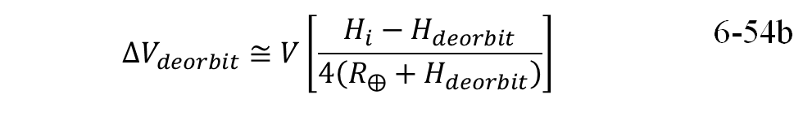
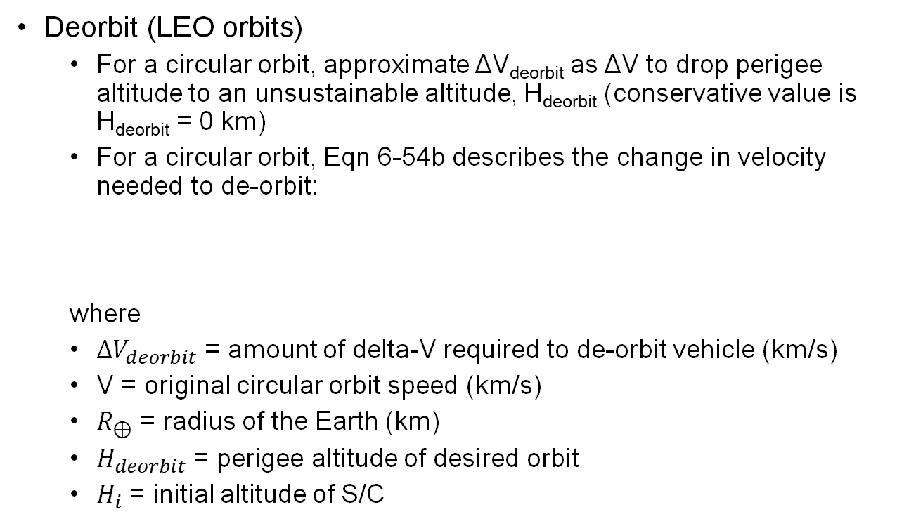
End-of-Life Disposal Options for S/C
Deorbit (LEO orbits)
For a circular orbit, approximate ΔV_{deorbit} as ΔV to drop perigee altitude to an unsustainable altitude, H_{deorbit} (conservative value is H_{deorbit} = 0 km)
For a circular orbit, Eqn 6-54b describes the change in velocity needed to de-orbit:
where
$ΔV_{deorbit}$ = amount of delta-V required to de-orbit vehicle (km/s)
V = original circular orbit speed (km/s)
$R_{⊕}$ = radius of the Earth (km)
$H_{deorbit}$ = perigee altitude of desired orbit
$H_{i}$ = initial altitude of S/C
$$ΔV_{deorbit}≅V\left[\frac{H_{i}−H_{deorbit}}{4\left(R_{⨁}+H_{deorbit}\right)}\right]$$ | 6-54b

Slide 24
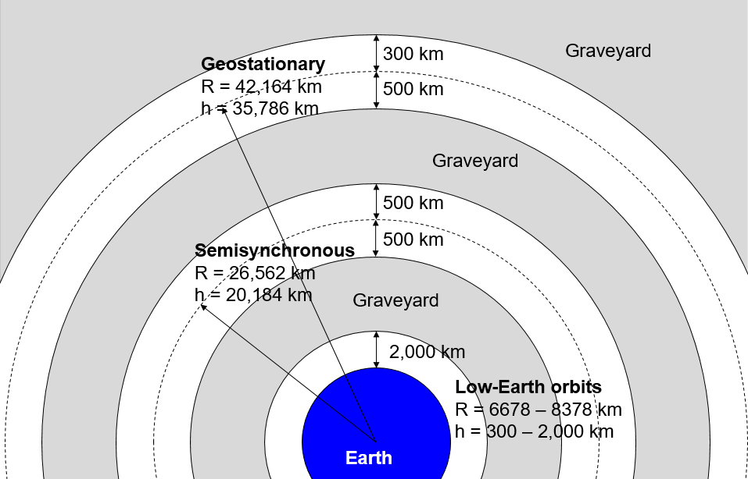
Maneuver to a graveyard orbit (higher orbits)
Vacate popular orbits for use by subsequent S/C
Graveyard zones:
perigee > 2,000 km up to 500 km below semi synch altitude
500 km above semi synch altitude up to 500 below geostationary altitude
300 km above geostationary altitude or higher (rqd by US gov’t regulations)
Retrieval (manned missions/sample return)

Slide 25
Example
Calculate the total ΔV required by a satellite on a 5-year mission in a geosynchronous orbit at 105° W with an inclination of 50° to account for east-west stationkeeping and 3rd body effects. Use the values in the table below to help you.
Angle between Earth’s equatorial plane and the Sun’s orbital plane | 23.45°
Angle between Earth’s equatorial plane and the Moon’s orbital plane | 5.1°
Spacecraft coefficient of drag | 2.2
Stable longitudes at geostationary orbit | 75° E and 225° E

Slide 26
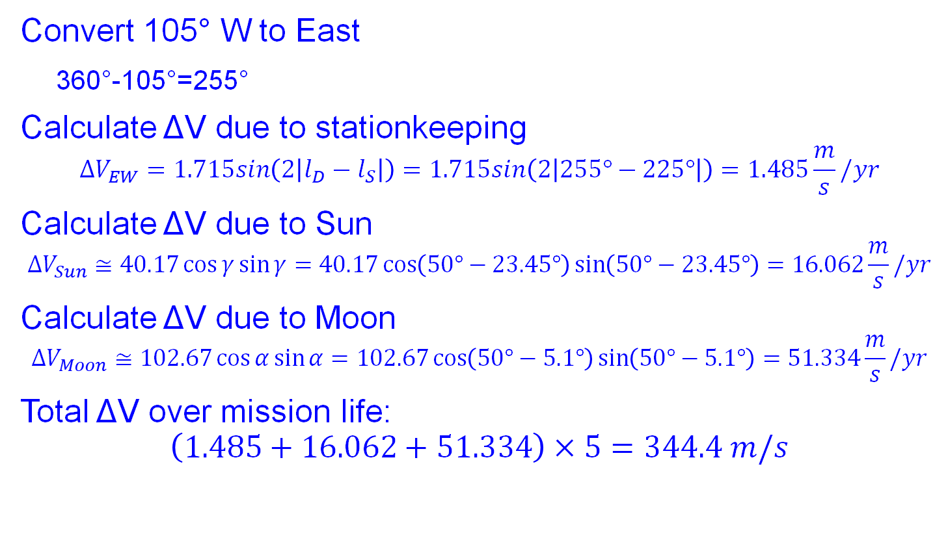
Solution
Convert 105° W to East
360°-105°=255°
Calculate ΔV due to stationkeeping
$$ΔV_{EW}=1.715sin\left(2\left|l_{D}−l_{S}\right|\right)=1.715sin\left(2\left|255°−225°\right|\right)=1.485\frac{m}{s}/yr$$
Calculate ΔV due to Sun
$$ΔV_{Sun}≅40.17\cos{γ}\sin{γ}=40.17\cos\left(50°−23.45°\right)\sin\left(50°−23.45°\right)=16.062\frac{m}{s}/yr$$
Calculate ΔV due to Moon
$$ΔV_{Moon}≅102.67\cos{α}\sin{α}=102.67\cos\left(50°−5.1°\right)\sin\left(50°−5.1°\right)=51.334\frac{m}{s}/yr$$
Total ΔV over mission life:
$$\left(1.485+16.062+51.334\right)×5=344.4 m/s$$

